Slide 1

Introduction to Classification Trees
Josiah Davis

Slide 2
Agenda
Interpretation
The Algorithm in Action
Code
Evaluation

Slide 3
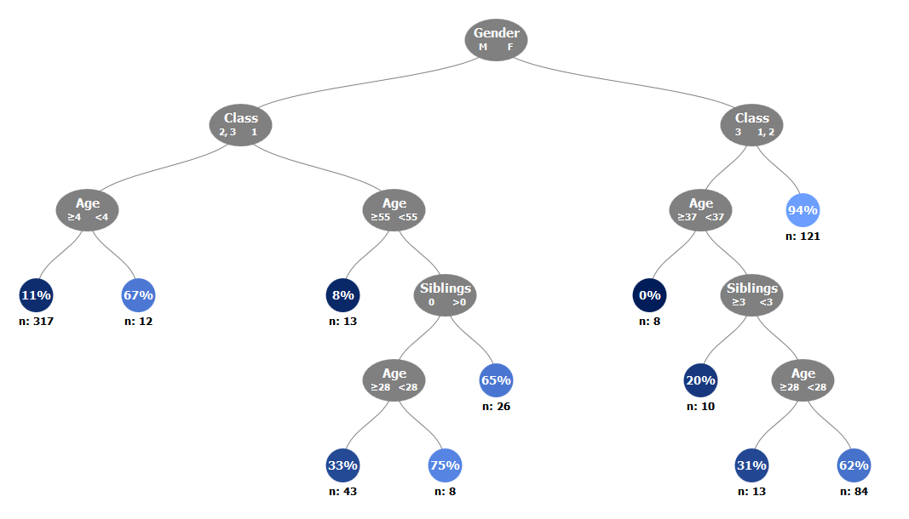
Interpretation
Classification and Regression Trees provide an output that is visually engaging and easy to interpret.

Slide 4

The Algorithm
in Action

Slide 5
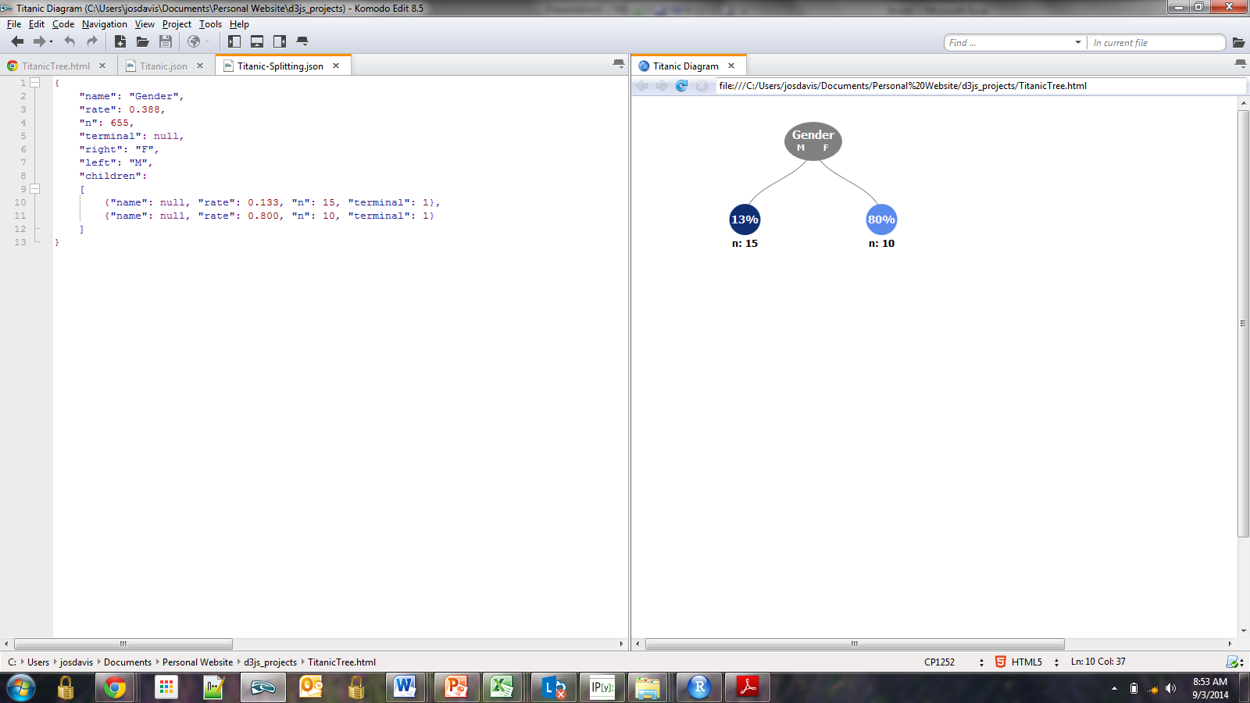
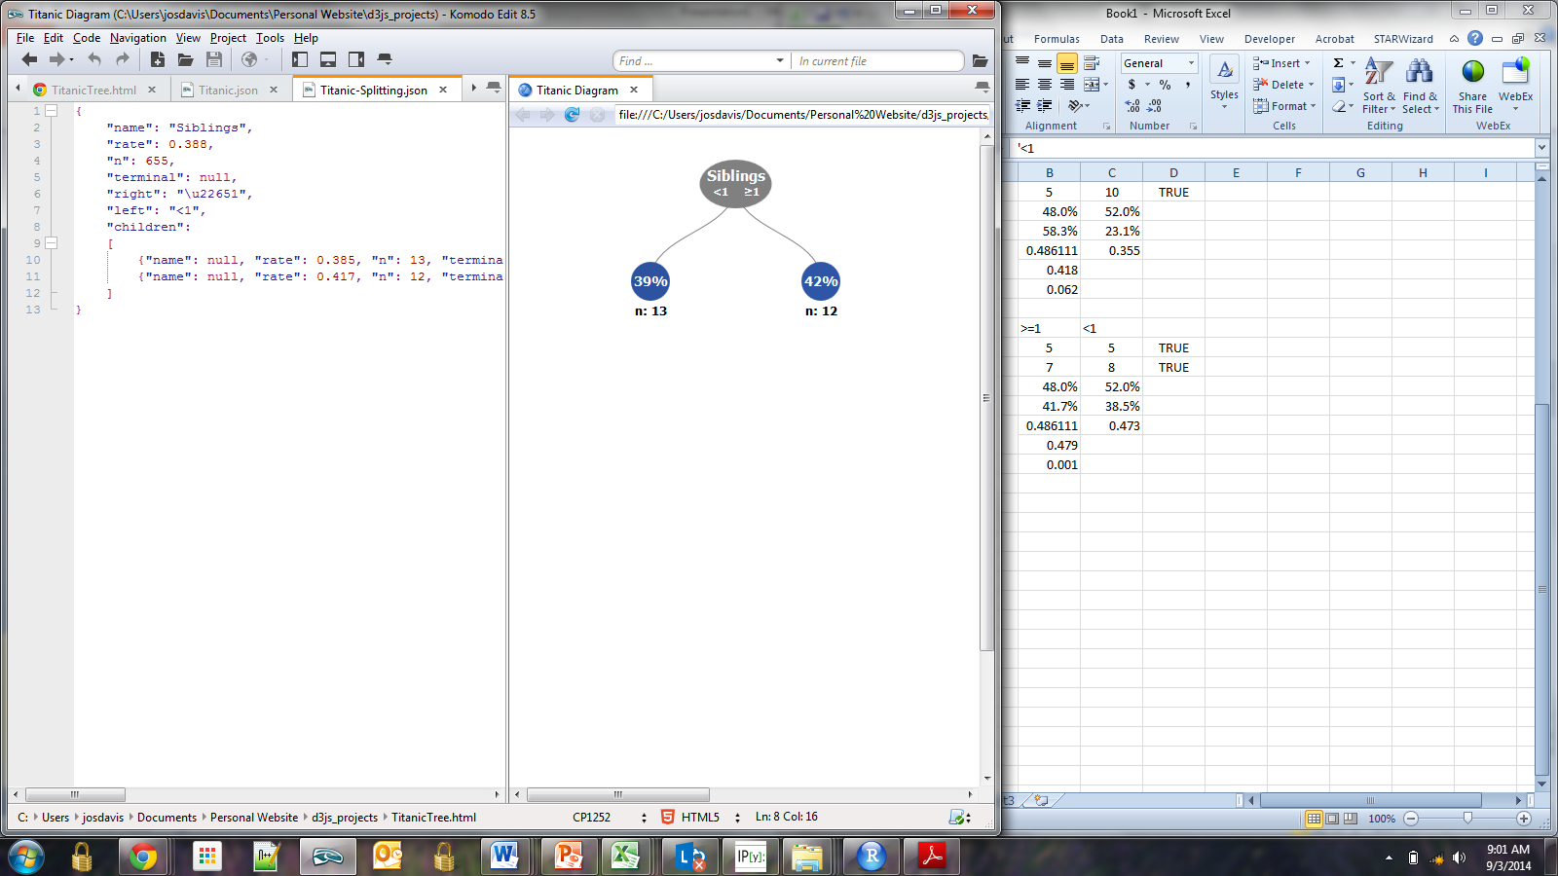
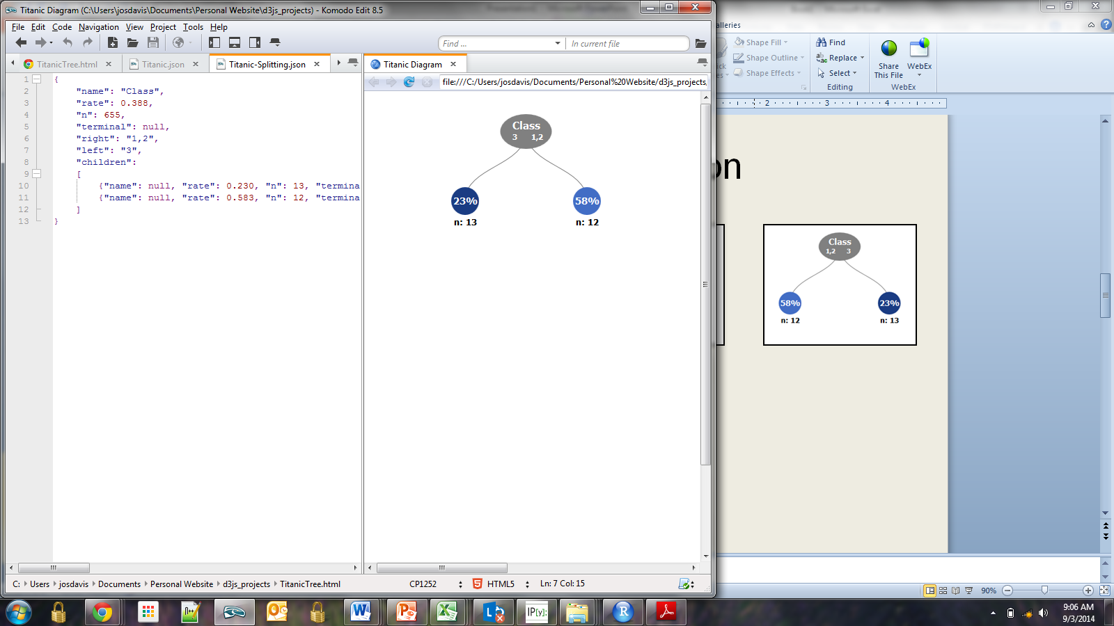
The Algorithm, Introduced
Different variables and split options are evaluated to determine which split will provide the greatest separation between classes.
Which split option would you select?
How can we determine the best split analytically?

Slide 6
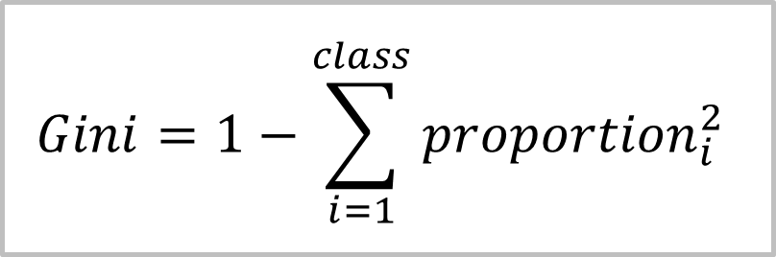
Measuring Information Gain
Information gain can be measured by calculating the difference in class homogeneity, as measured by the Gini index, before and after the split
$$Gini=1−\sum_{i=1}^{class}{{proportion}_{i}^{2}}$$
A Gini index of 0.5 indicates equal representation between both classes, and a Gini index of 0 indicates perfect separation between classes.

Slide 7
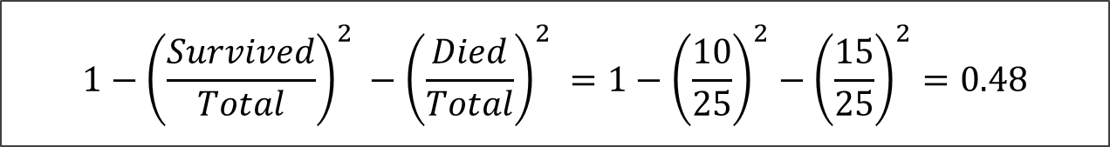
Before the Split
Before Split | All
Survived | 10
Died | 15
Gini_{O}
$$1−{\left(\frac{Survived}{Total}\right)}^{2} −{\left(\frac{Died}{Total}\right)}^{2} =1−{\left(\frac{10}{25}\right)}^{2}−{\left(\frac{15}{25}\right)}^{2}=0.48$$

Slide 8
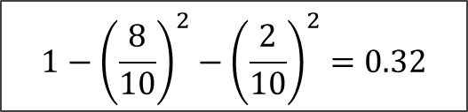
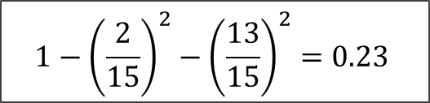
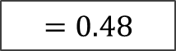
After the Split
Gini_{O}
$$=0.48$$
Gender | M
Survived | 2
Died | 13
Gender | F
Survived | 8
Died | 2
Gini_{M}
Gini_{F}
$$1−{\left(\frac{2}{15}\right)}^{2}−{\left(\frac{13}{15}\right)}^{2}=0.23$$
$$1−{\left(\frac{8}{10}\right)}^{2}−{\left(\frac{2}{10}\right)}^{2}=0.32$$

Slide 9
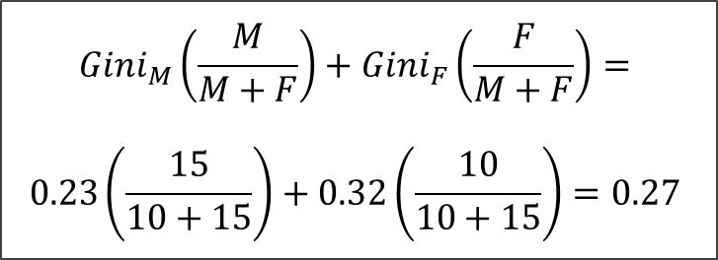
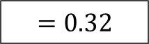
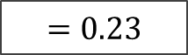
After the Split (continued)
Gini_{O}
$$=0.48$$
Gini_{M}
Gini_{F}
$$=0.23$$
$$=0.32$$
Gini_{C}
$${Gini}_{M}\left(\frac{M}{M+F}\right)+{Gini}_{F}\left(\frac{F}{M+F}\right)=$$
$$0.23\left(\frac{15}{10+15}\right)+0.32\left(\frac{10}{10+15}\right)=0.27$$

Slide 10
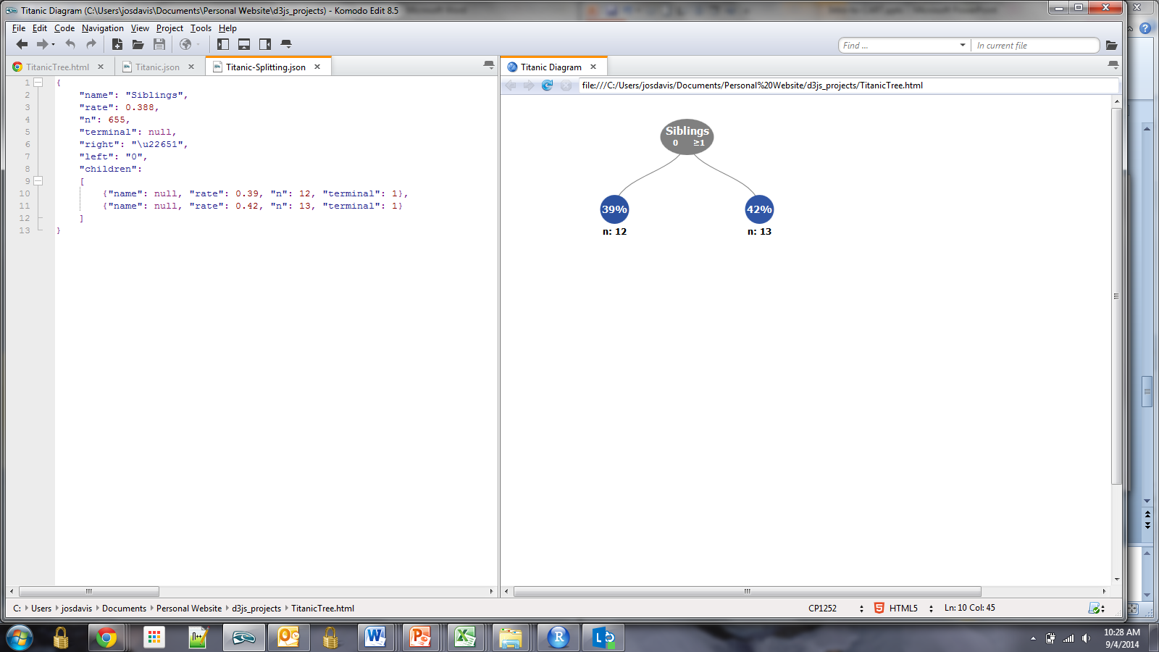
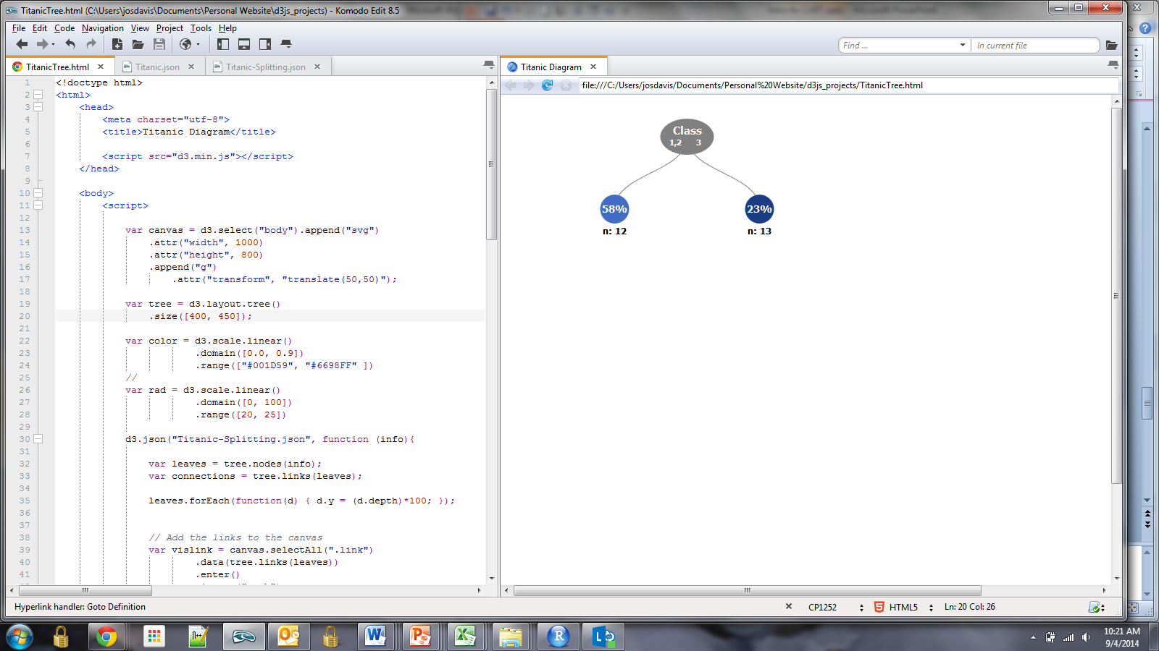
Choosing the Split
In this example, the algorithm will select the Gender variable since it provides the greatest information gain.
Gender | M | F
Survived | 2 | 8
Died | 13 | 2
Gini_{C} | 0.27
Siblings | 0 | ≥1
Survived | 5 | 5
Died | 7 | 8
Gini_{C} | 0.48
Class | 1,2 | 3
Survived | 7 | 3
Died | 5 | 10
Gini_{C} | 0.42
Notes:
Edit these charts

Slide 11

Code

Slide 12
Creation in R
Classification trees can be implemented in R using the rpart package:
> m.tree <- rpart(formula,
data,
control = rpart.control(
minsplit = 30,
maxdepth = 5,
cp = 0.01))
> as.data.frame(m.tree$variable.importance)
Sex 92.130450
Pclass 25.755781
Age 15.102265
Embarked 10.445809
Parch 6.665129
SibSp 3.106558

Slide 13
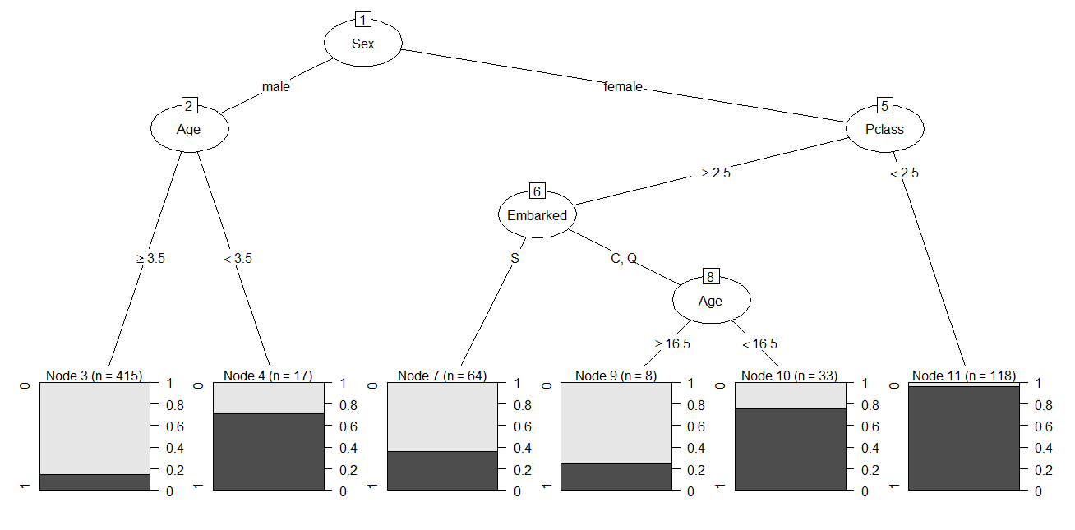
Plotting in R
Classification trees can be plotted in R using the partykit package
plot(as.party(m.tree))

Slide 14
Tuning in R
Classification trees can tuned in R using the caret package
> m.train <- train( formula, data, method = "rpart2", trControl = trainControl(
method = "cv", p = 0.60,
number = 10), tuneLength = 5))
> m.train$results[,1:2]
maxdepth Accuracy
1 0.7895030
2 0.7935992
3 0.8031406
4 0.8011100
6 0.8105104

Slide 15

Evaluation

Slide 16
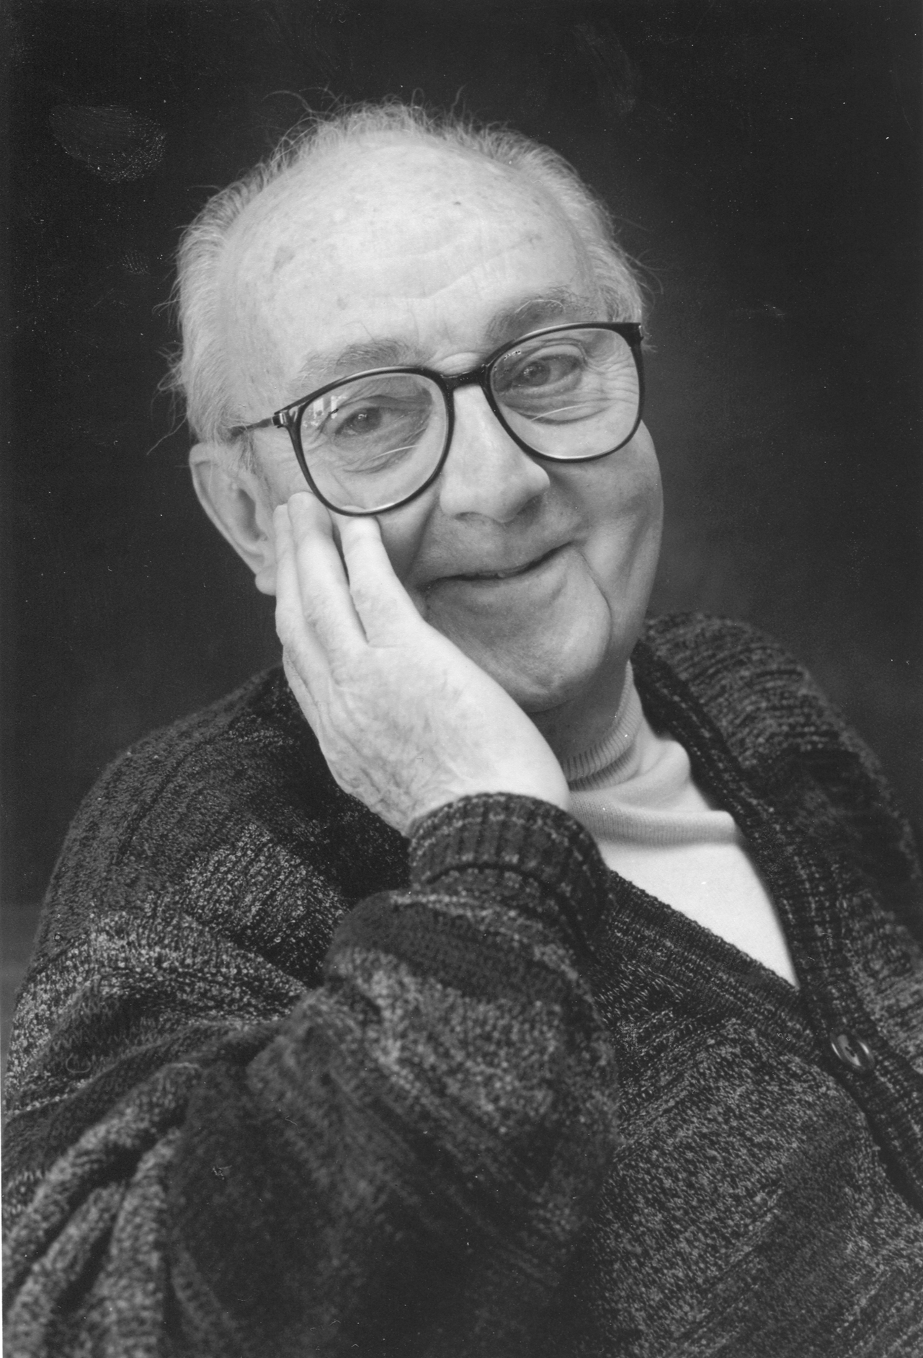
Statisticians, like artists, have a bad habit of falling in love with their models
George Box

Slide 17
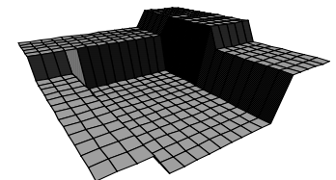
Con: Performance
The Classification Tree tends to perform worse than more sophisticated modeling techniques
Chart from Elder Research Inc.

Slide 18

Pro: Transparency
The nature of its output provides the Classification tree algorithm with a degree of interpretability that other more complex algorithms don’t provide

Slide 19
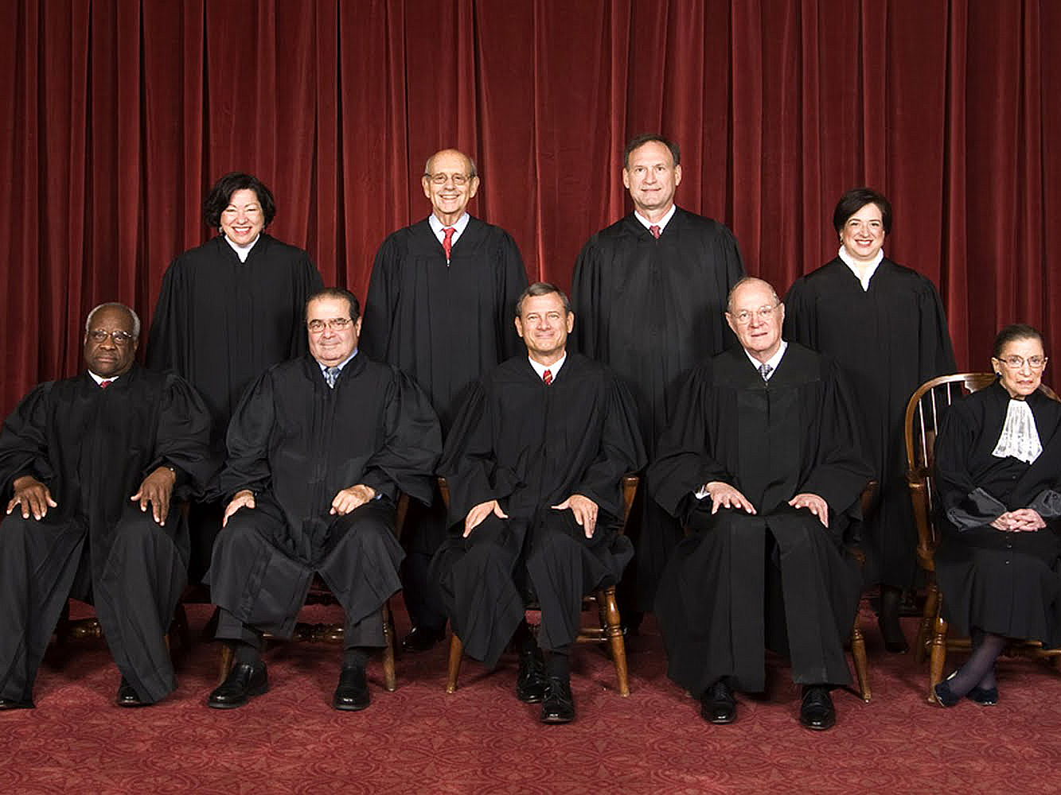
Pro: Widely Used
Understanding how the Classification Tree works is foundational to understanding how more complex, and widely-used models work, such as random forests and boosted trees.
Source: The Oyez Project
http://www.oyez.org/courts/robt6
Notes:
Good article on the Supreme Court Algorithm: http://www.vox.com/2014/8/4/5967147/how-a-computer-model-got-to-predict-70-of-supreme-court-decisions

Slide 20

The End

